Slide 1

CS302 Design and Analysis of Algorithms
Muhammad sohail afzal

Slide 2
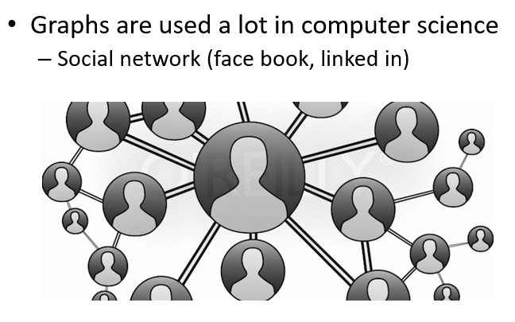
Graphs

Slide 3
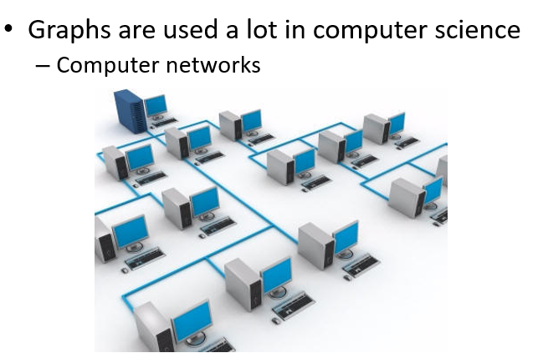
Graphs

Slide 4
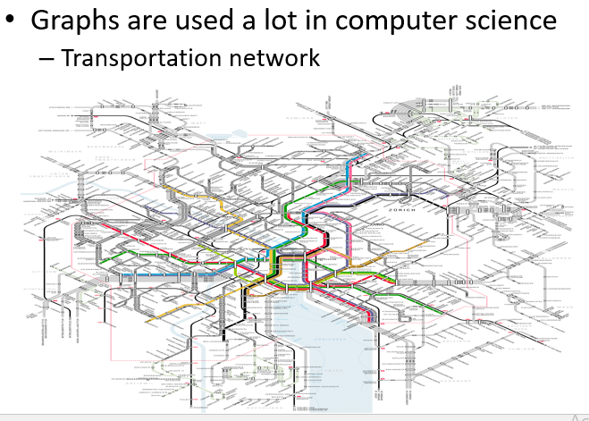
Graphs

Slide 5
Graphs
It has two main types :
Directed graphs (also known as digraphs)
These graphs have edges with direction. The edges indicate one way relationship in that each edge can only be traversed in one direction
Undirected graphs
These graphs have edges that do not have direction. Edges indicate a two way relationship in that each edge can be traversed in both directions.

Slide 6
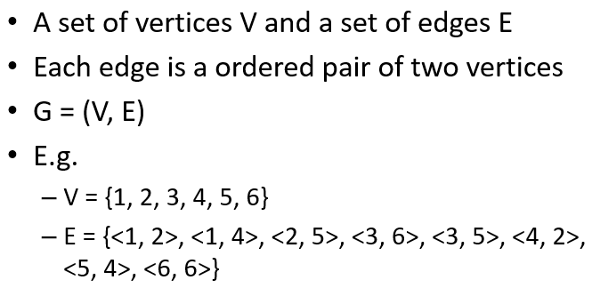
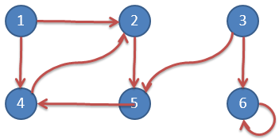
Graphs: Directed graph

Slide 7
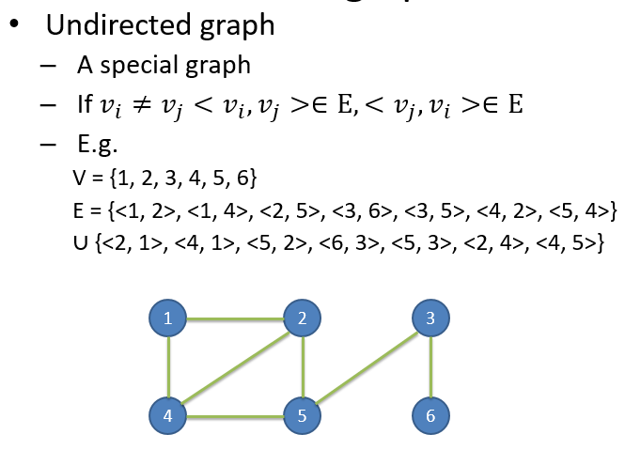
Graphs : Undirected graph

Slide 8
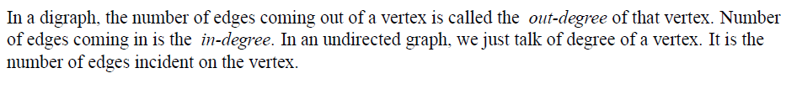
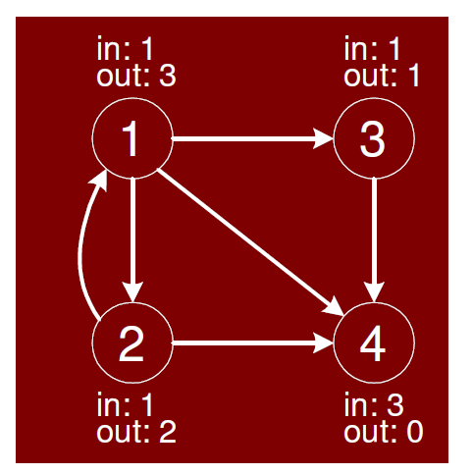
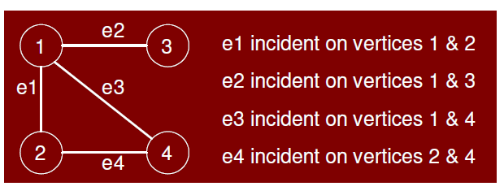
Graphs: in degree & out degree

Slide 9
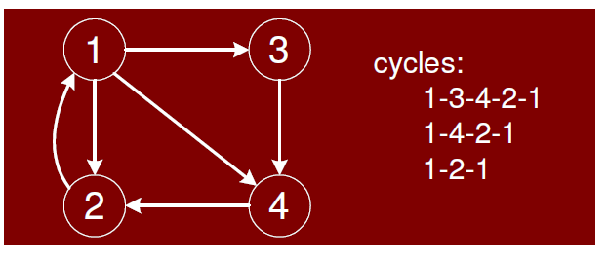
Graphs : Cycles in digraph

Slide 10
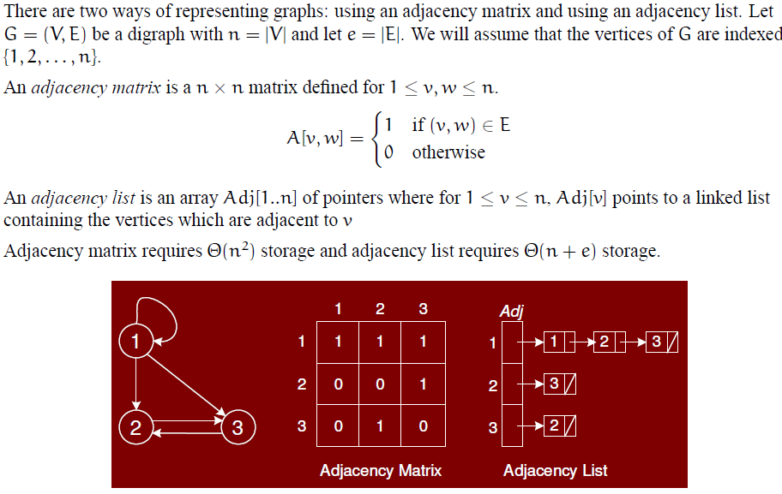
Graphs: How to represent graph

Slide 11
Graph Traversal
Two techniques of graph traversing for both directed or undirected graphs:
Breadth First Search (BFS) – Uses Queue
Depth First Search (DFS) – Uses Stack

Slide 12
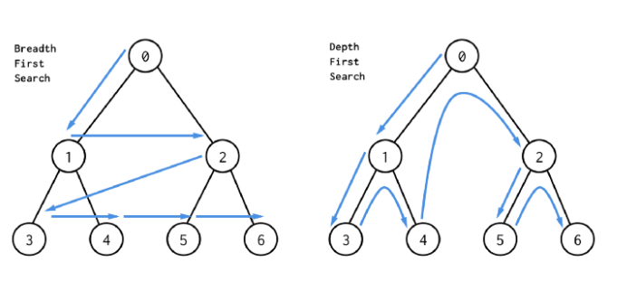
Graph Traversal
BFS = 0,1,2,3,4,5,6 DFS = 0,1,3,4,2,5,6

Slide 13
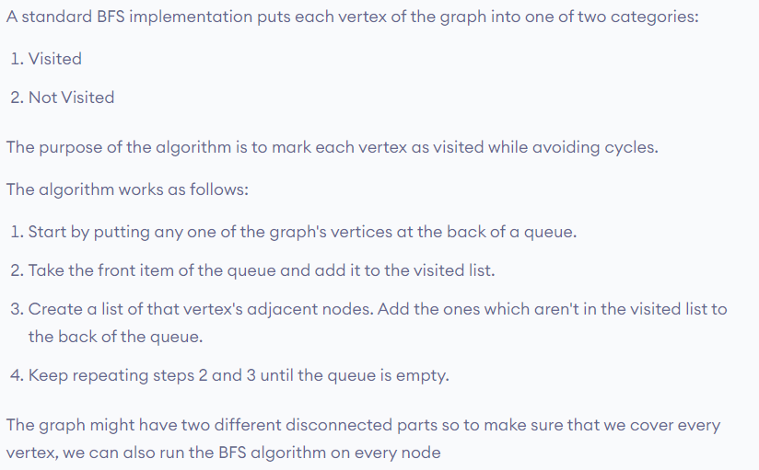
Graph Traversal : BFS
Visit starting vertex and then visit its neighbors and then neighbors of neighbors and so on

Slide 14
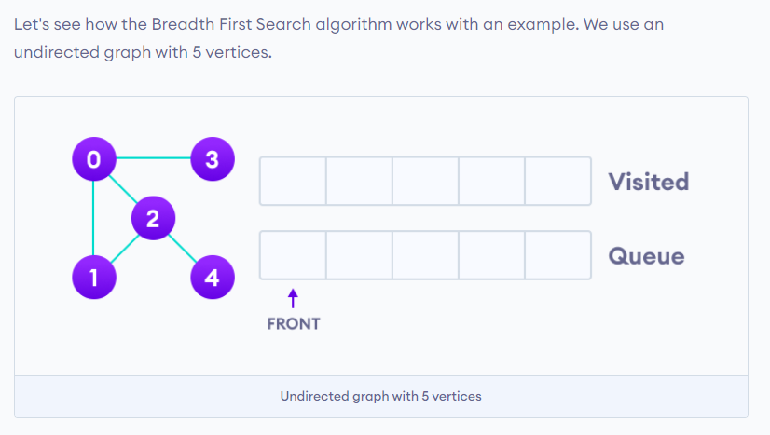
Graph Traversal : BFS

Slide 15
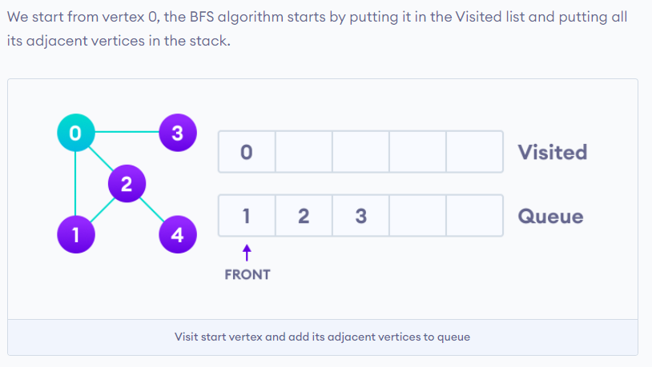

Graph Traversal : BFS
Pushing element in queue from right
and popping from left

Slide 16
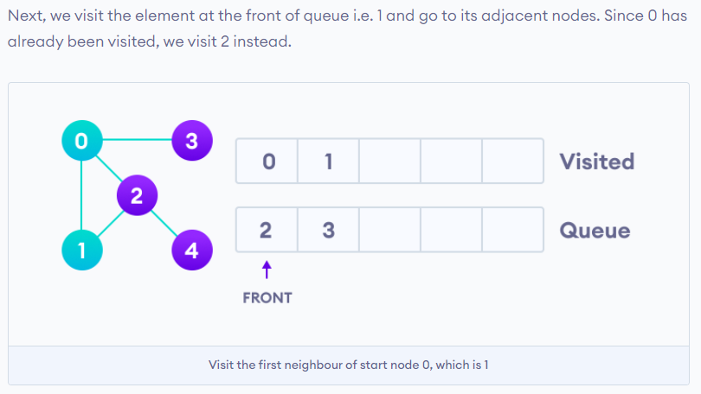
Graph Traversal : BFS

Slide 17
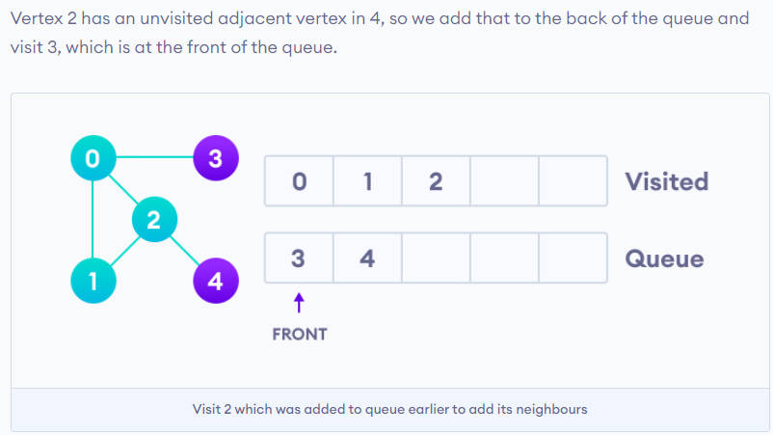
Graph Traversal : BFS

Slide 18
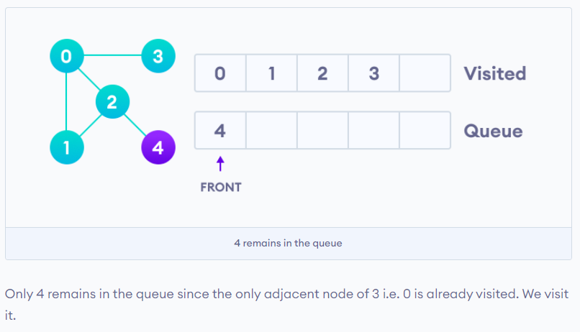
Graph Traversal : BFS

Slide 19
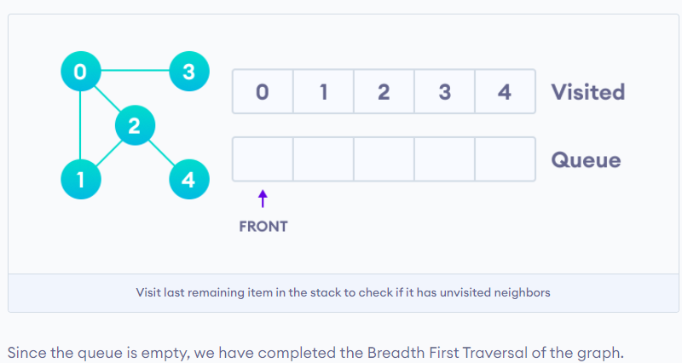
Graph Traversal : BFS

Slide 20
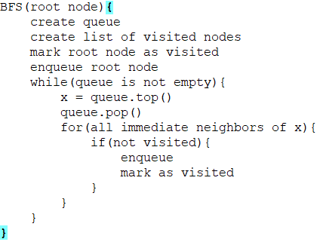
Graph Traversal : BFS

Slide 21
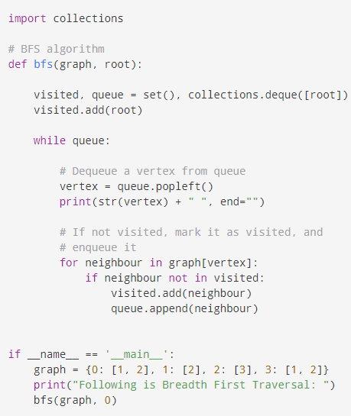
Graph Traversal : BFS
Time complexity = O(V+E)

Slide 22
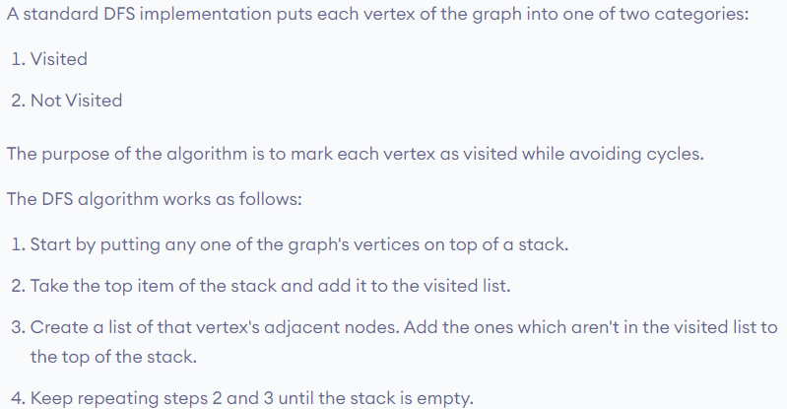
Graph Traversal : DFS
DFS traversal takes any path from starting vertex and goes into its depth. Then it back tracks and traverse any other path and goes in the depth of that too. And this goes on..

Slide 23
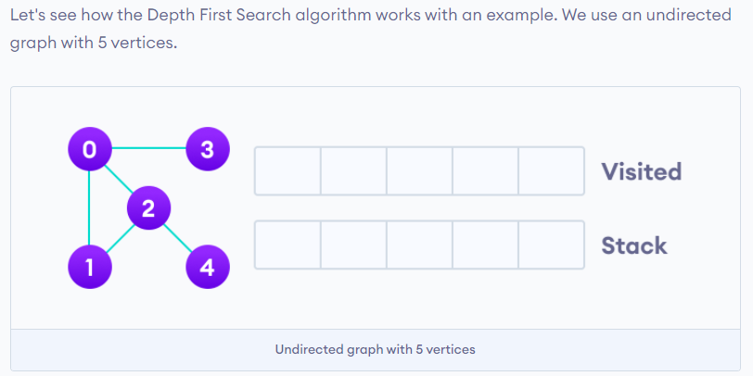
Graph Traversal : DFS

Slide 24
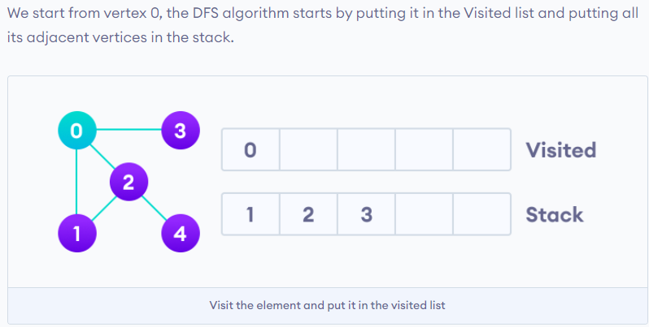
Graph Traversal : DFS
Pushing and popping element in
stack from left

Slide 25
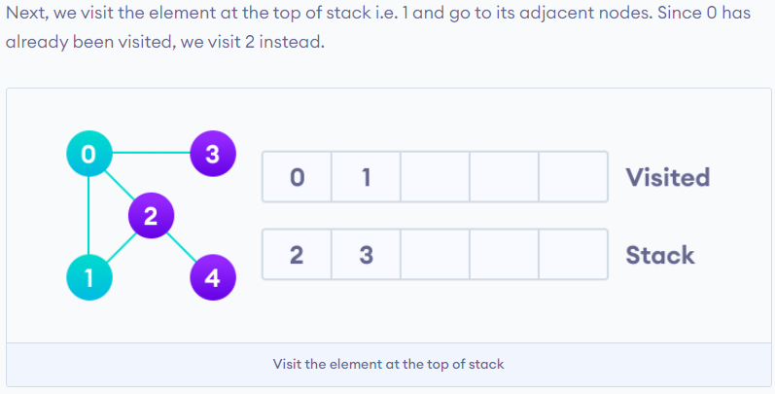
Graph Traversal : DFS

Slide 26
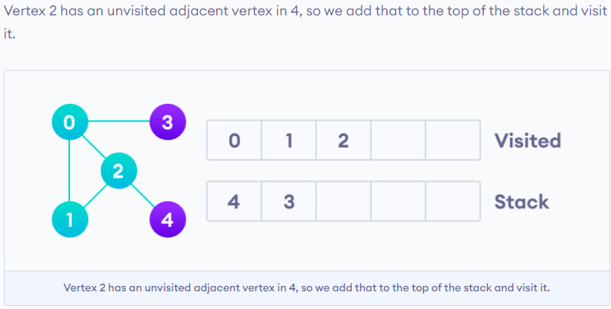
Graph Traversal : DFS

Slide 27
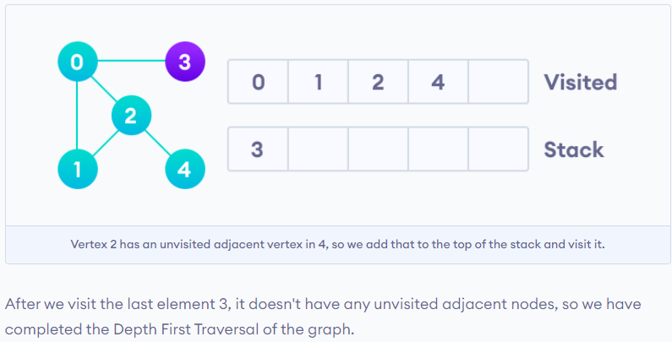
Graph Traversal : DFS

Slide 28
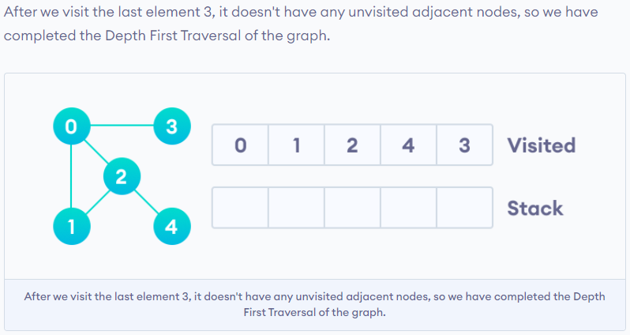
Graph Traversal : DFS

Slide 29
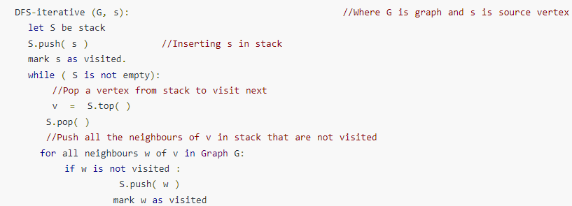
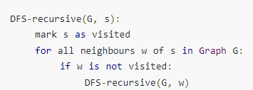
Graph Traversal : DFS

Slide 30
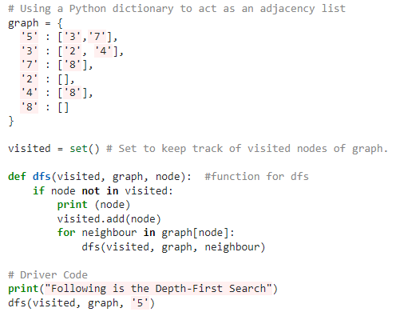
Graph Traversal : DFS
Time complexity = O(V+E)
Recursive DFS code

Slide 31
Graph Traversal : Time complexity and Applications
Time complexity of BFS and DFS is O(V+E) because all vertices and edges will be visited
Applications of BFS & DFS:
For finding path from one vertex to every other
For detecting cycles
For GPS navigation
and etc

Slide 32
Graph Traversal : Applications
When to use DFS over BFS or BFS over DFS :
If you know a solution is not far from the root of the tree, a breadth first search (BFS) might be better.
If the tree is very deep and solutions are rare, depth first search (DFS) might take an extremely long time, but BFS could be faster.
If the tree is very wide, a BFS might need too much memory, so it might be completely impractical.
If solutions are frequent but located deep in the tree, BFS could be impractical.
If the search tree is very deep you will need to restrict the search depth for depth first search (DFS), anyway (for example with iterative deepening). Queue

